Slide 1
Elkins & RidgePoint High School 11th Grade Parent Night Presentation
September 2023

Slide 2
Who am I
What do I do
Where am I located
When can you see me?

Slide 3
Lead Counselor, Dina Powis
Last Names Sn - Z
Dina.Powis@fortbendisd.com
281-634-2613
Counselor, Kathleen Fey
Last Names A - Cha
Kathleen.Fey@fortbendisd.com
281-634-2607
Counselor, Richerica Wolf
Last Names Chb - G
Richerica.Wolf@fortbendisd.com
281-634-9843
Counselor, Ivy James
Last Names H - Le
Ivy.BowenJames@fortbendisd.com
Counselor, Elisha Carter
Last Names Li - Pao
Elisha.Carter@fortbendisd.com
281-634-2612
Counselor, Braiyon Sands
Last Name Pap - Sm
Braiyon.Sands@fortbendisd.com
281-634-2612
Counselor Clerk, Andrea Adams
Andrea.Adams@fortbendisd.com
281-634-3070
Counselor Clerk, Mary Sullivan
MaryE.Sullivan@fortbendisd.com
281-634-6257
Your EHS Counseling Team
ABOUT COUNSELING
Professional School Counselors are available at Lawrence Elkins High School to provide a Comprehensive Developmental Guidance Program and services for all students in the areas of: Guidance Curriculum - In an effort to help students develop competence in essential life skills
Responsive Services - Provide intervention for immediate personal/social/emotional concerns
Individual Planning - Provide guidance to help students plan, monitor, and manage their personal, educational and career goals, and facilitate transition activities for post-secondary education and/or training
System Support - Support campus staff, parents, and community to promote the educational, career, personal, and social development of students, as well as the Developmental Guidance Program
EHS High School Code (CEEB) 446782 EHS SAT TEST CENTER CODE 44-845 EHS ACT TEST CENTER CODE 156760

Slide 4
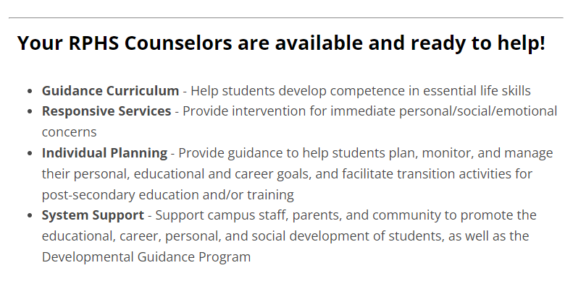
Your RPHS Counseling Team
Kaylynn Will, Lead Counselor (last names U-Z)
Melanie Blain-Tannous (last names A-C)
Brandi Goodly (last names D-He)
Tim Hemlin (last names Re-T)
Jill Tschetter (last names Martin-Ra)
Angela White (last names Hi-Marshall)
Andrea Garcia, Counselor Clerk

Slide 5
Important Changes for 2023-2024
in the world of FBISD CCR:
Shared CCMR Advisor Shared Model
SchooLinks replacing Naviance
Graduation requirements changes: FAFSA, & CPR
CCMR District-Wide Events :Pathways to Success: College, Career, and Military Readiness Event Series

Slide 6
FBISD District-wide CCMR Events
* Save the Dates & Mark Your Calendars!

Slide 7
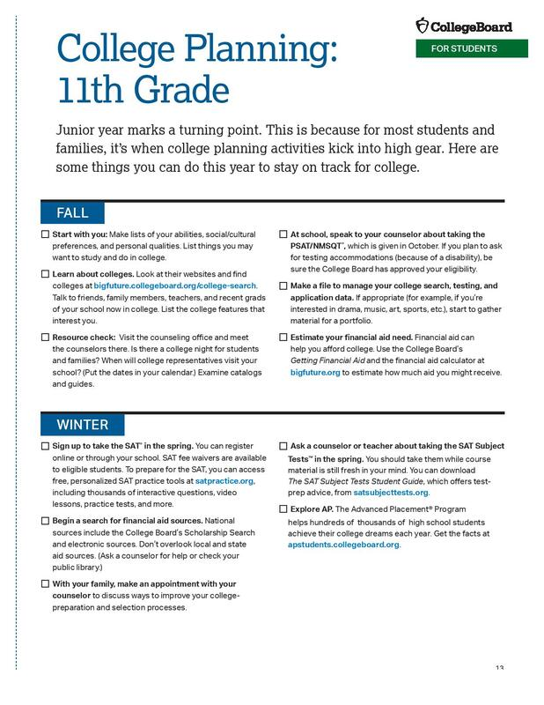
^{11th} Grade CCMR
To Do List
by the Month

Slide 10
Types of College Apps Systems: Create Application Profile August 1, 2024
Common App
ApplyTexas
Commonapp.org
Many ApplyTexas colleges are also in CommonApp
1st create CommonApp profile/application & then link via SchooLinks
Consider completing all of your colleges apps. via www.Commonapp.org
ApplyTexas.org
Public colleges in Texas and a few private colleges

Slide 11
Types of Colleges – Ivy, Private, Public, Etc.
Open Admissions, Technical, etc
Ivies – Public & Private, Selective Colleges

Slide 12
Auto Admit does NOT mean You Got your College Major

Slide 13
Tests, Tests, Tests – Do I need to send or NOT??
ACT vs SAT - Try to complete both or either by October to meet December 1st app. Deadlines.
SAT is NOT your only option
Many students do very well on the ACT
TSI – Offered 3 times this year
Optional
Blind
Look for the average test score
of those accepted and decide if you will
send
* Rule of thumb
If your score is lower than the
average admitted test scores for the
college that you are interested in
– Do NOT send test score
Use the gift of test optional

Slide 14
Register to take SAT & ACT
SAT Test https://mysat.collegeboard.org/login
ACT Test
www.ACT.org

Slide 15
SchooLinks:
All Things College & Career Ready
SchooLinks replaced Naviance
SchooLinks Overview
What is SchoolLinks?
New college and career readiness platform that allows students to explore, plan and realize their post secondary goals. Seniors will request transcripts for all college applications, and complete 5 more “senior tasks” in SchoolLinks
All students must complete the initial onboarding process ASAP

Slide 16
2 Excused Absence College visits this year & CCR Has 2 College Fieldtrips TBD
A student shall be excused for up to two (2) days during the student’s junior year and up to two (2) days during the student’s senior year to visit an accredited institution of higher education.
I suggest making 3 day weekends, 4 day weekends and allowing your student to attend 2-3 colleges visits in a day. This requires prior planning and connecting with current students and asking to shadow for an authentic experience.
A student shall be required to submit verification of such visit(s) by providing:
A letter from the university/college verifying the date(s) and purpose of the visit in order to be counted present for attendance accounting purposes. The same place you can schedule the college visit ahead of time on-line.
If a university/college verification letter is not submitted with in two (2) school days after the visit, the absence(s) will be considered unexcused.

Slide 17
Money, Money, Money, Money…for College, Career, Military.

Slide 18
Finding Scholarships in SchooLinks

Slide 19
ROTC SCHOLARSHIPS
Military Branches – ROTC Scholarship
TAMU Corps of Cadets
If your seniors are interested in military service they can apply for ROTC scholarships online now, they pay tuition, academic fees, spending money and book allowance.
Army https://www.goarmy.com/rotc/scholarships.html
Air Force / Space Force https://www.afrotc.com/scholarships/high-school/types/
Navy / Marine Opens April 1 - https://www.netc.navy.mil/Commands/Naval-Service-Training-Command/NROTC/Apply/

Slide 20
Email Etiquette
Who are you?
What school Do you attend?
What is your student ID#
Greetings
Contact info.
Communicate how you want
to be communicated to

Slide 21
Thank you for your attention!
The Elkins & Ridge Point HS’s CCR & Counseling team
wishes you the best as you assist your children in their post-high school pursuits!

Slide 22
FORT BEND ISD
16431 Lexington Blvd.
Sugar Land, TX 77479
281-634-1000
www.fortbendisd.com

